Slide 1
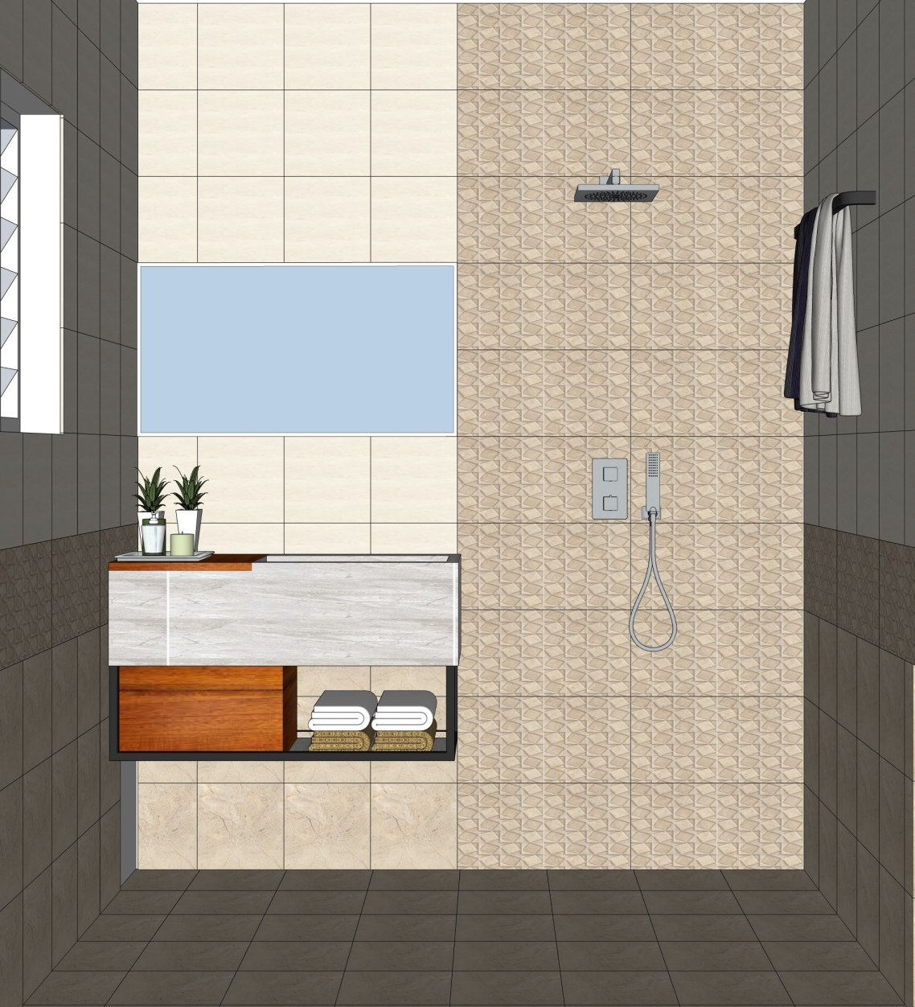

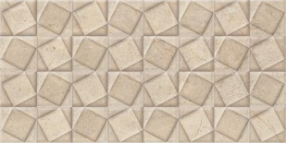
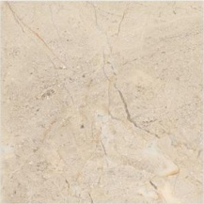
PARENTS BEDROOM TOILET
SIMPOLO TILES
CASTEL CREMA
300x600mm | 9.5mm | Glossy |
LINK
SIMPOLO TILES
CASTEL BEIGE HL
300x600mm | 9.5mm | Glossy |
LINK
SIMPOLO TILES
FLORA CASTEL BEIGE
300x300mm | 8.5mm | Satin |
LINK

Slide 2
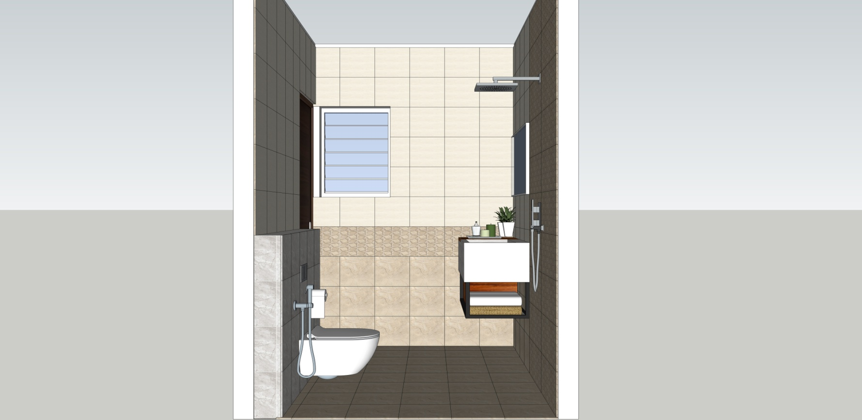
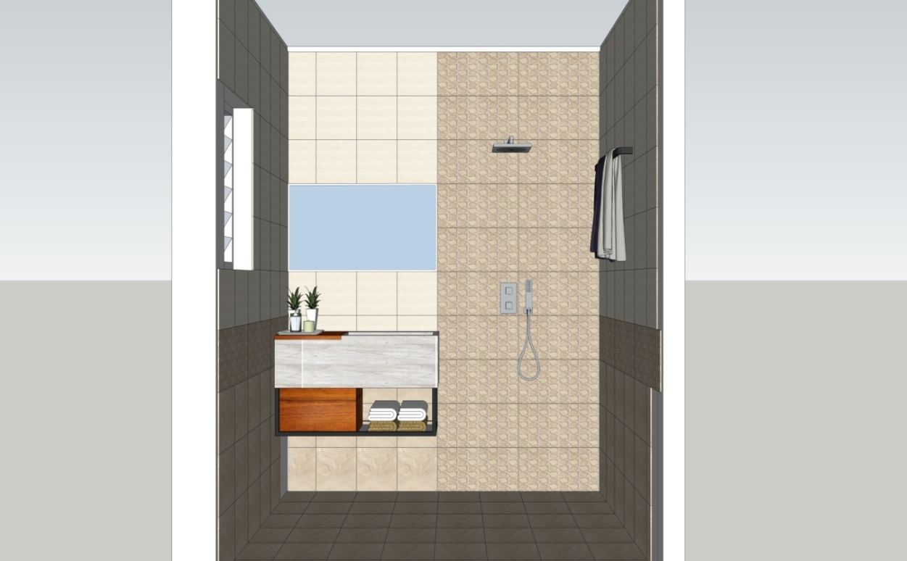
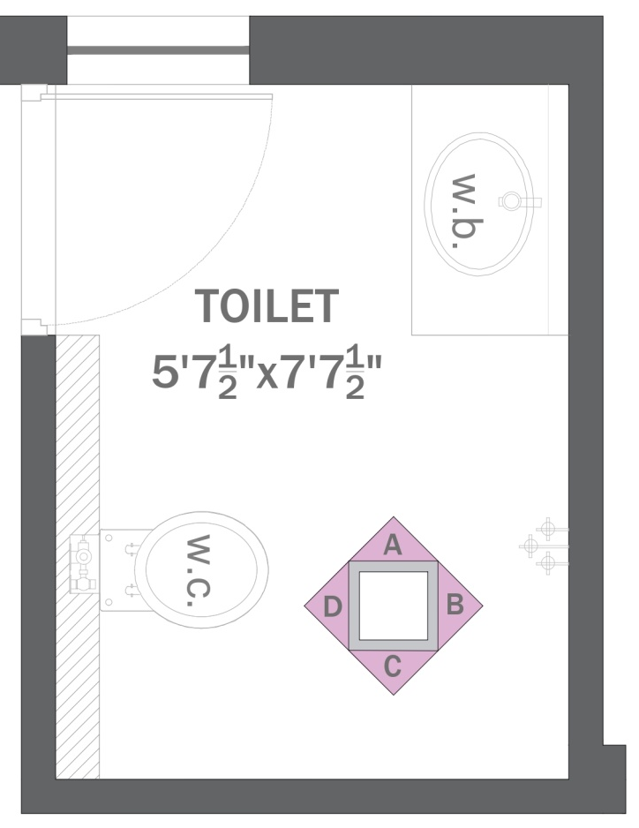
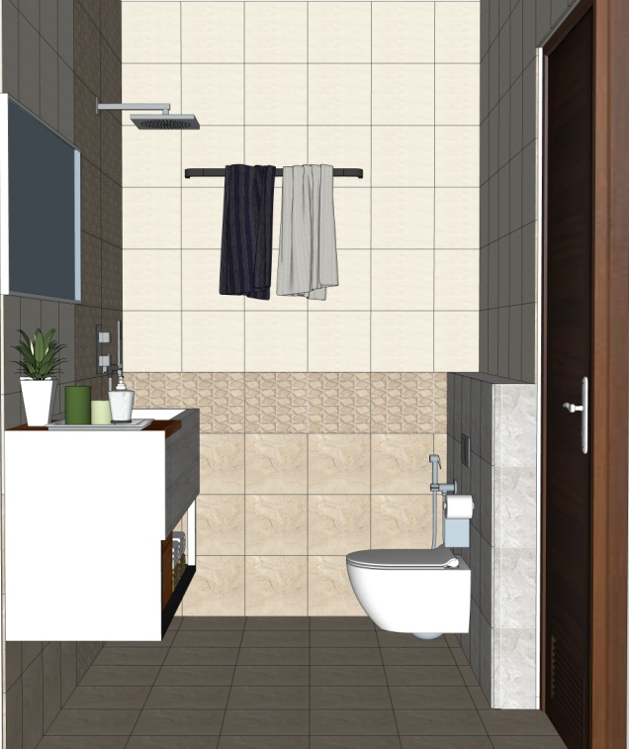
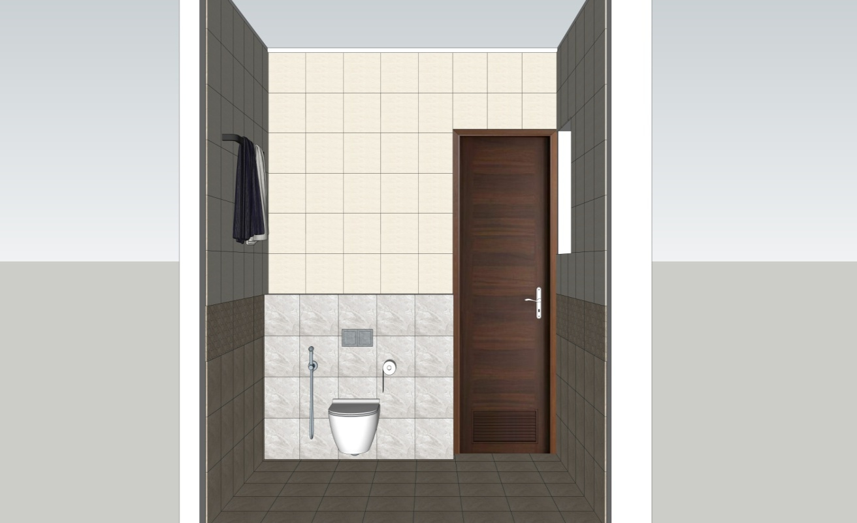
ELEVATION-A
ELEVATION-B
PARENTS BEDROOM TOILET
PLAN
ELEVATION-C
ELEVATION-D

Slide 3

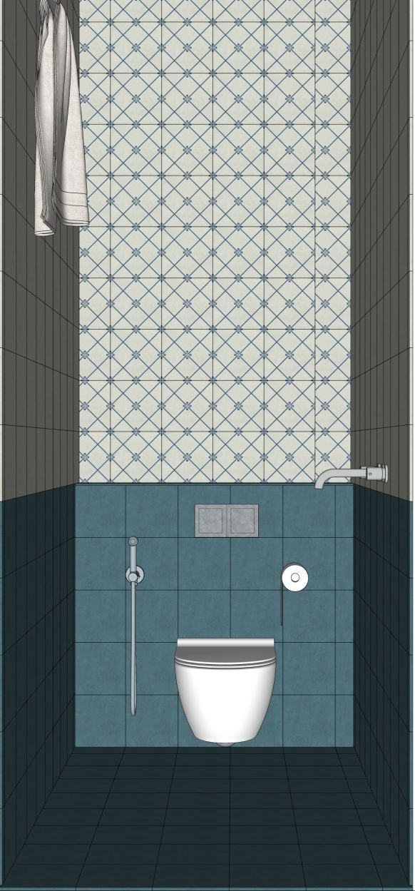


POWDER ROOM
SIMPOLO TILES
NAVY DECOR 1
198X198mm | 8.5mm | Matt|
LINK
SIMPOLO TILES
NEO CHALK
198X198mm | 8.5mm | Matt|
LINK
SIMPOLO TILES
SPECTRA BERRY
198X198mm | 8.5mm | Matt|
LINK

Slide 4

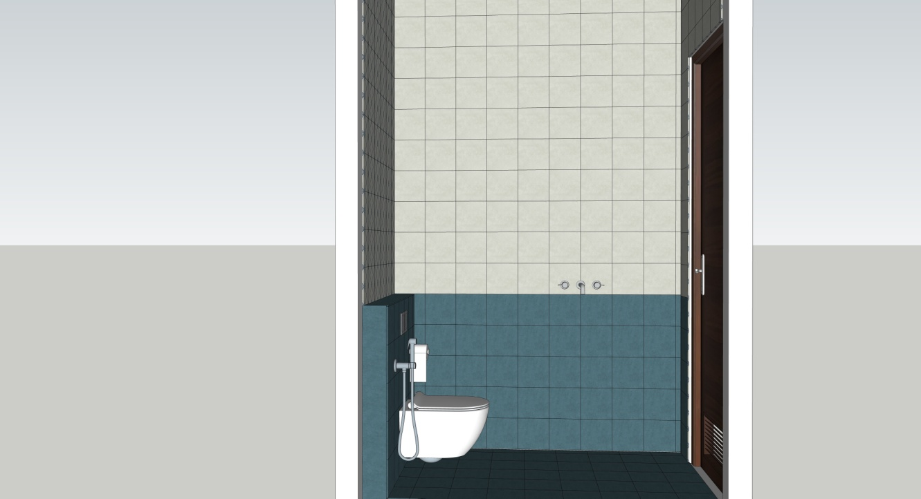
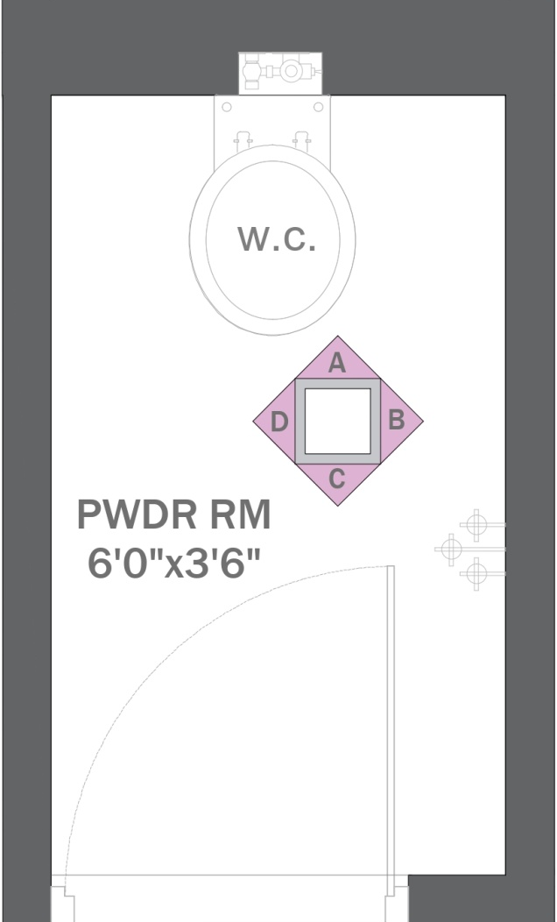

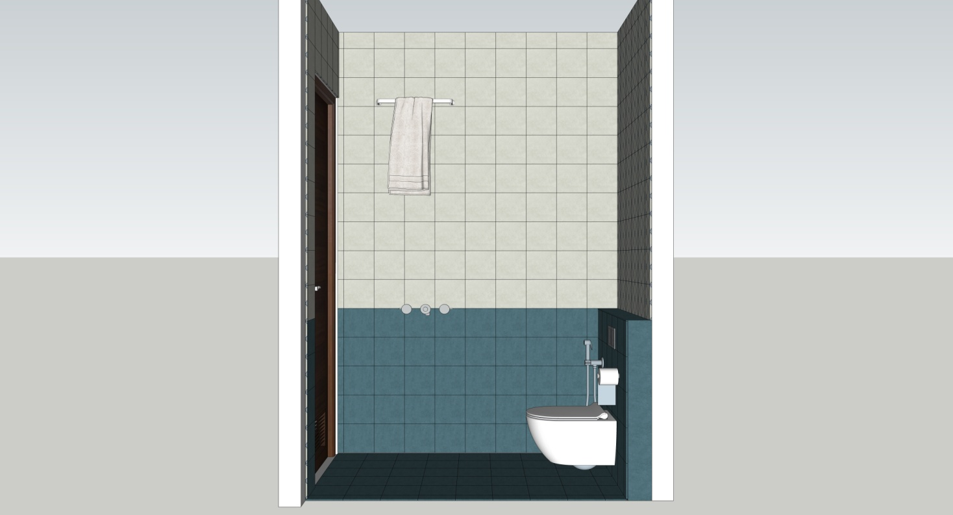
ELEVATION-A
ELEVATION-B
POWDER ROOM
PLAN
ELEVATION-C
ELEVATION-D

Slide 5
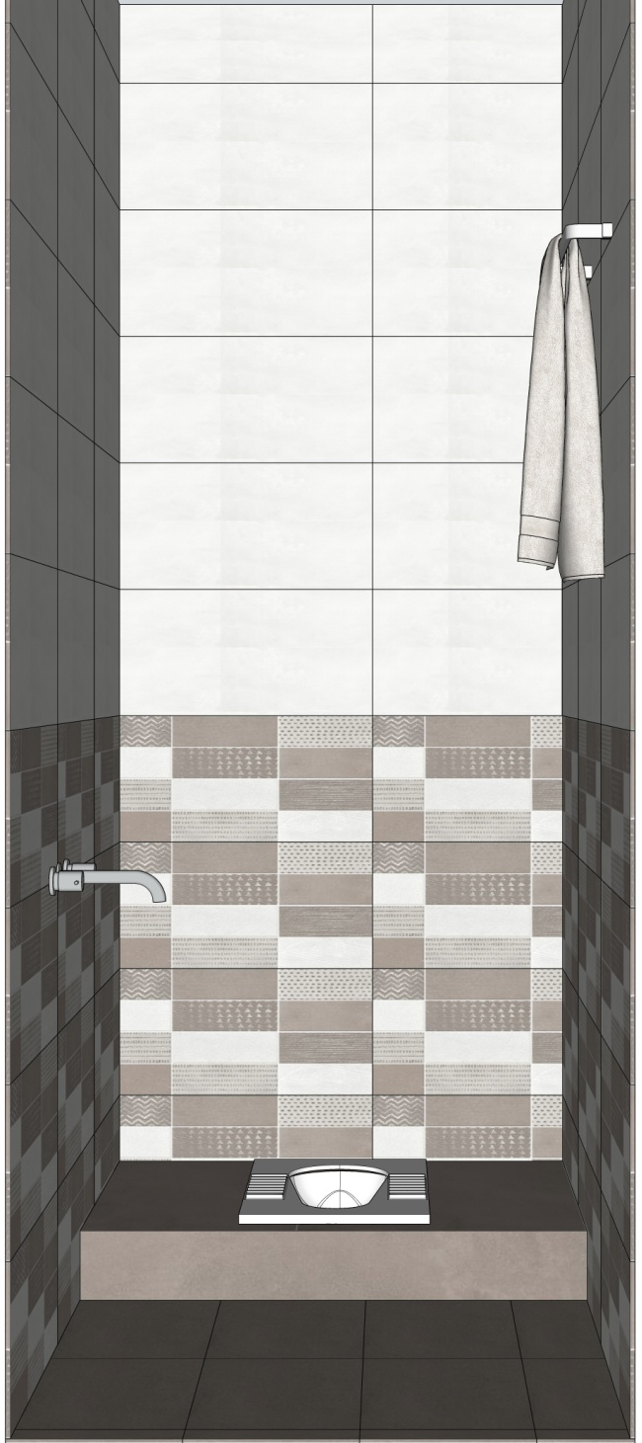

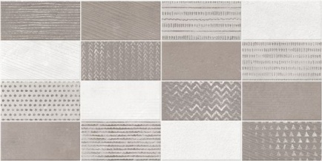

SERVANT ROOM TOILET
SIMPOLO TILES
17009 – FLORA SKID
300X600mm | 9.5mm | SATIN|
LINK
SIMPOLO TILES
27009 – FLORA SKID
300X600mm | 9.5mm | SATIN|
LINK
SIMPOLO TILES
37009 – FLORA SKID
300X600mm | 9.5mm | SATIN|
LINK

Slide 6
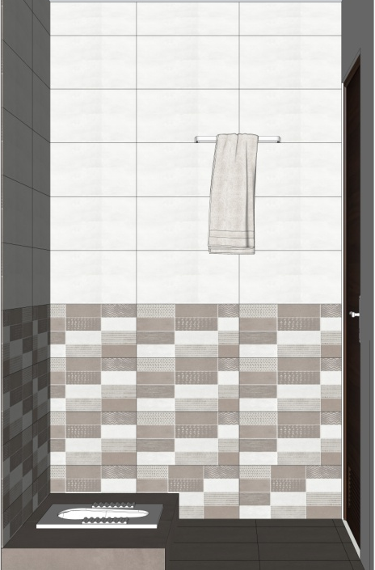
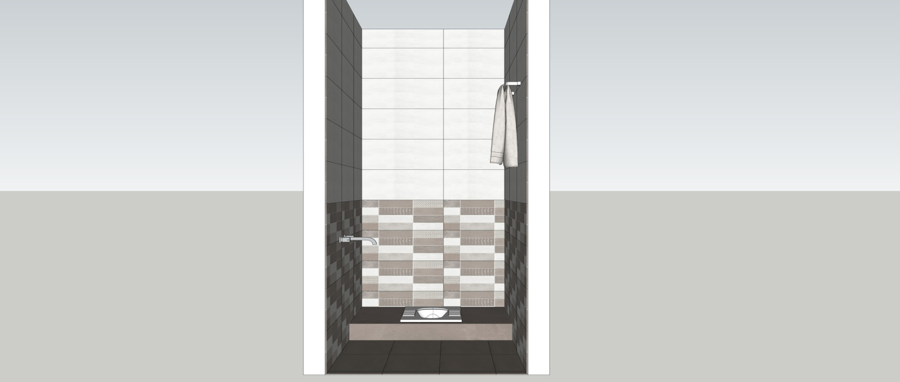
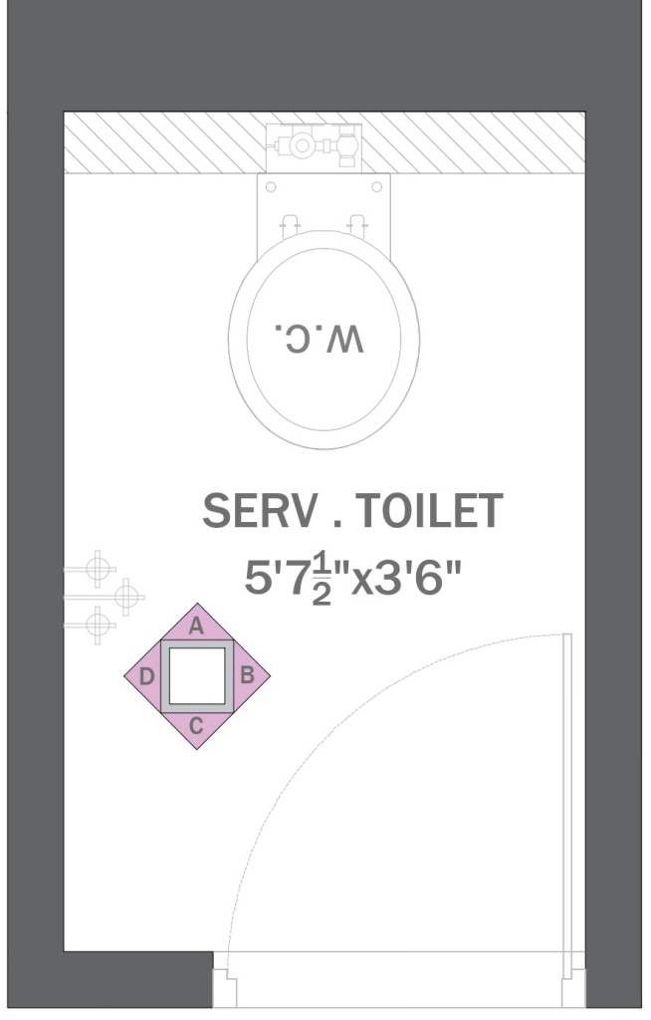
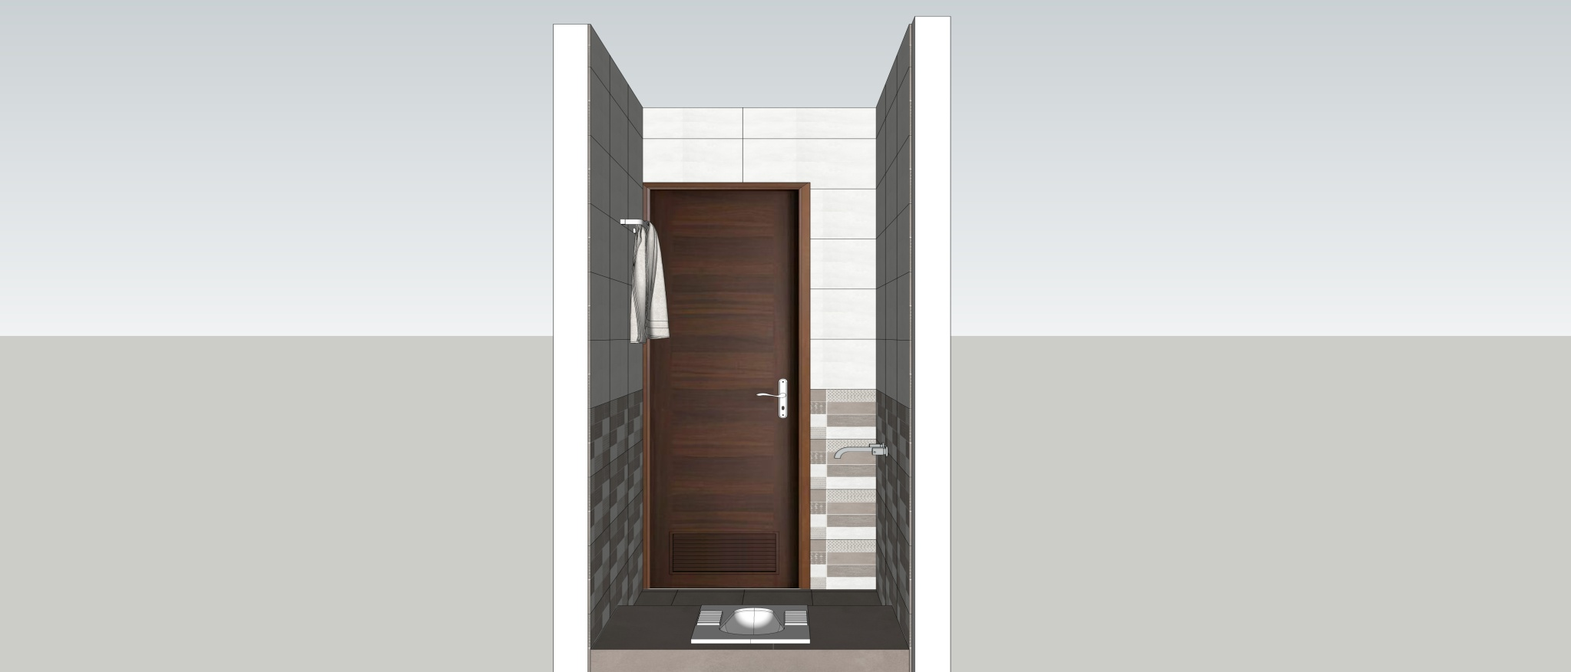
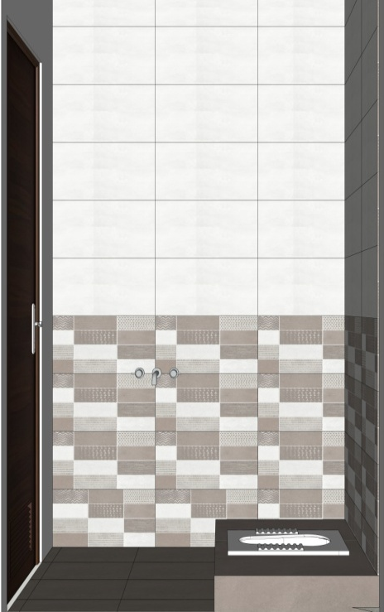
ELEVATION-A
ELEVATION-B
SERVANT ROOM TOILET
PLAN
ELEVATION-C
ELEVATION-D

Slide 7

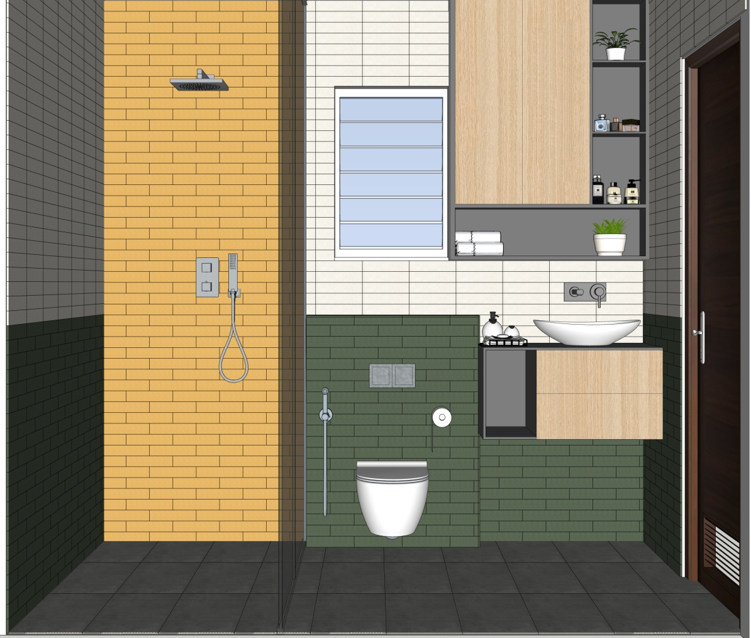


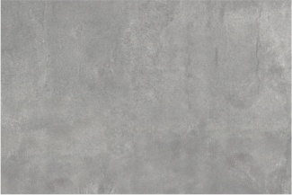
MASTER BEDROOM TOILET
SIMPOLO TILES
SPECTRA SALT
58X250mm | 8.5 mm | MATT|
LINK
SIMPOLO TILES
SPECTRA HERBS
58X250mm | 8.5 mm | MATT|
LINK
SIMPOLO TILES
SPECTRA HERBS
58X250mm | 8.5 mm | MATT|
LINK
SIMPOLO TILES
86011– FLORA SKID
300X450mm | 8.2 mm | MATT|
LINK

Slide 8
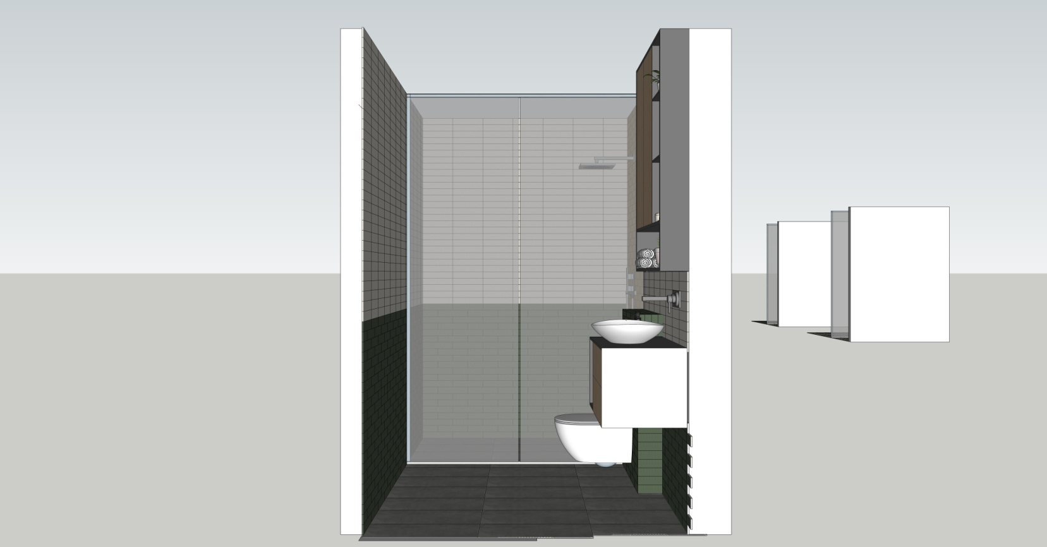

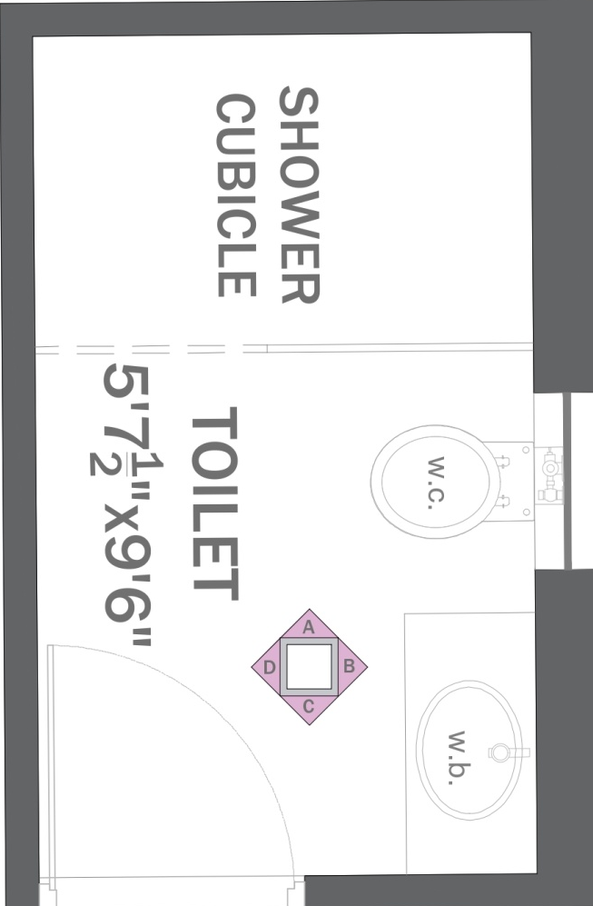
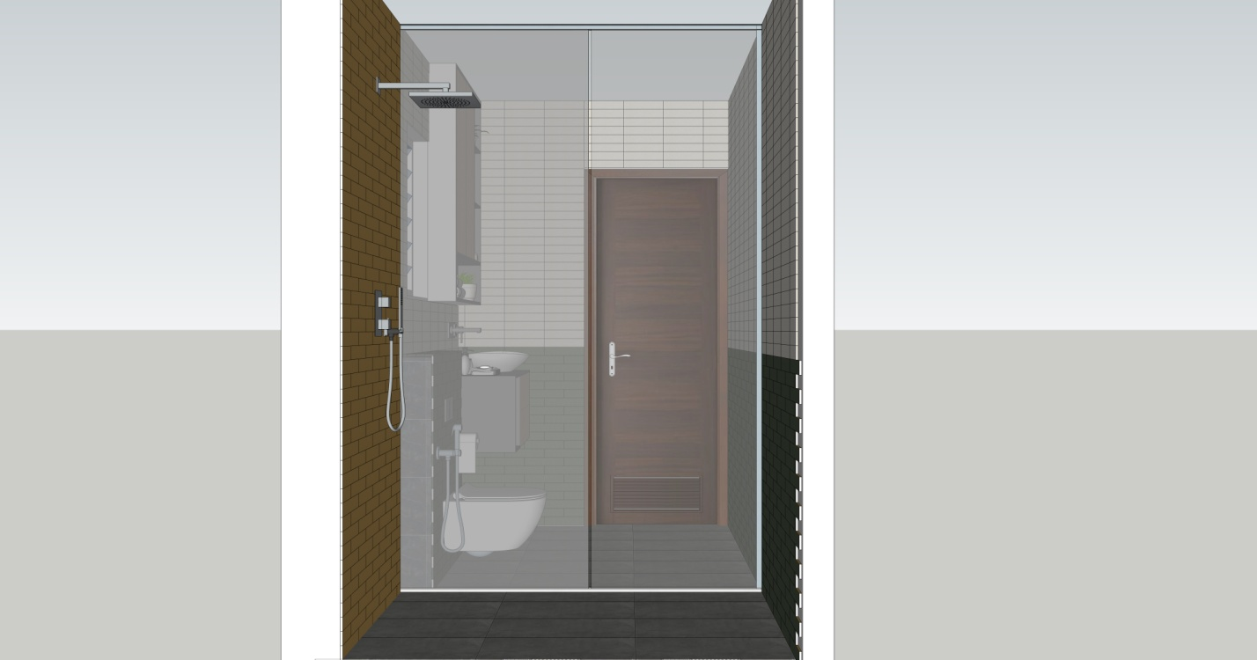
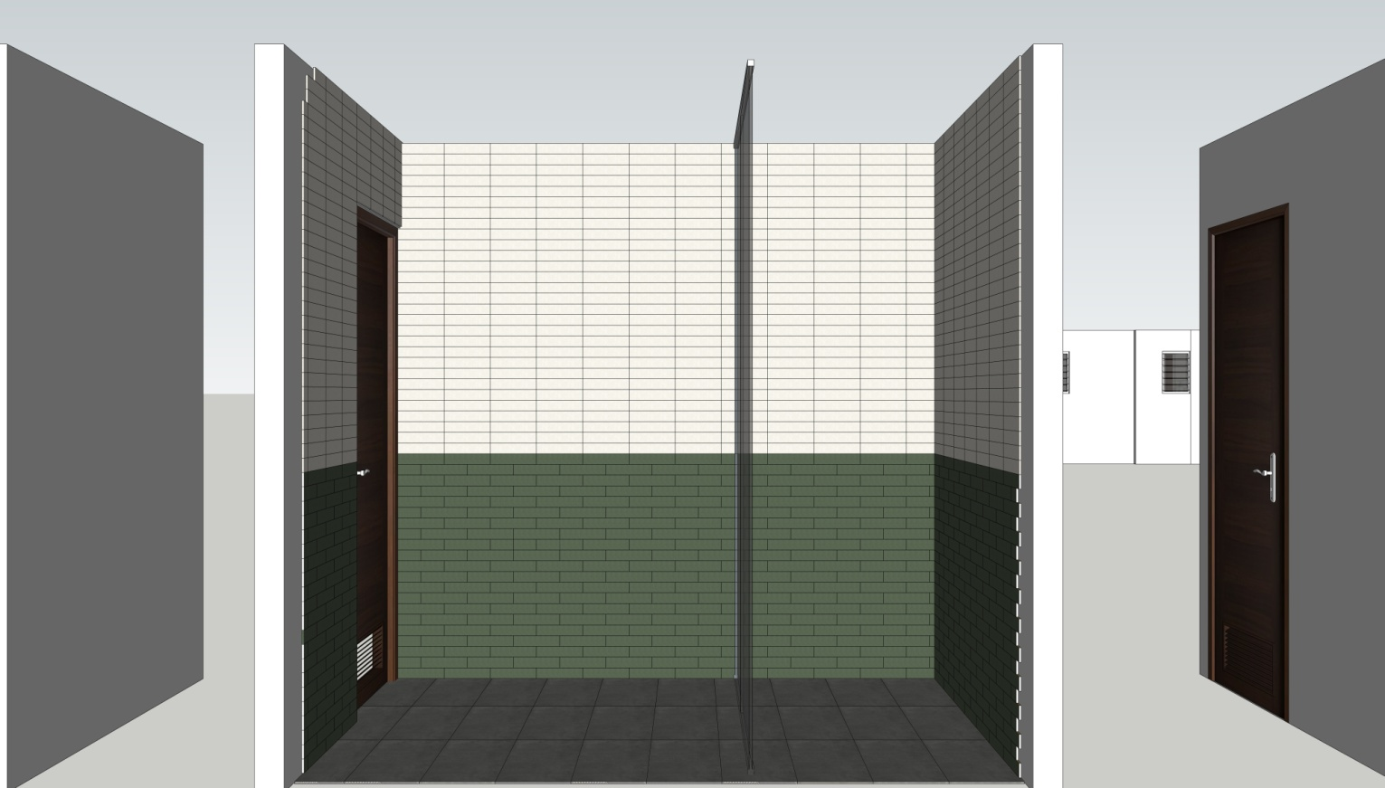
ELEVATION-A
ELEVATION-B
MASTER BEDROOM TOILET
PLAN
ELEVATION-C
ELEVATION-D

Slide 9
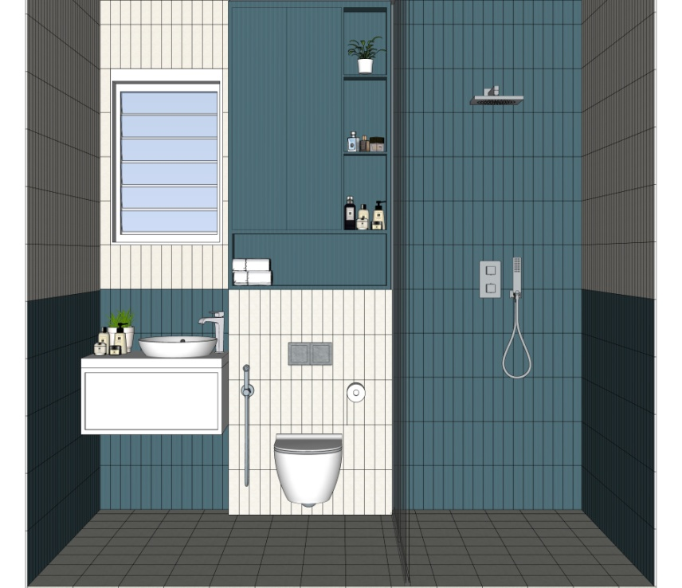

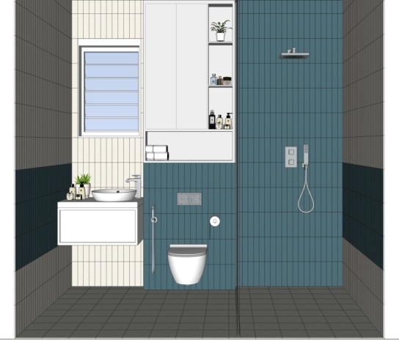
CHILDREN BEDROOM TOILET
SIMPOLO TILES
SPECTRA BERRY
58X250mm | 8.5 mm | MATT|
LINK
SIMPOLO TILES
SPECTRA SALT
58X250mm | 8.5 mm | MATT|
LINK
SIMPOLO TILES
NEO CHALK
198X198mm | 8.5 mm | MATT|
LINK
OPTION 1
OPTION 2

Slide 10
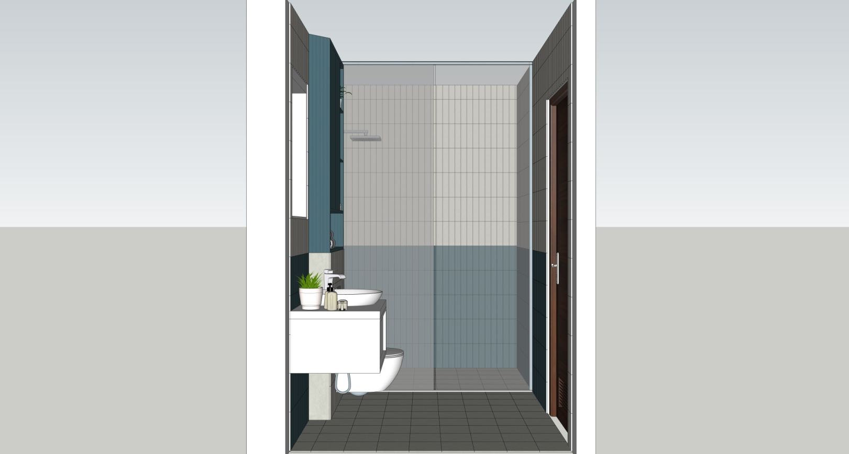
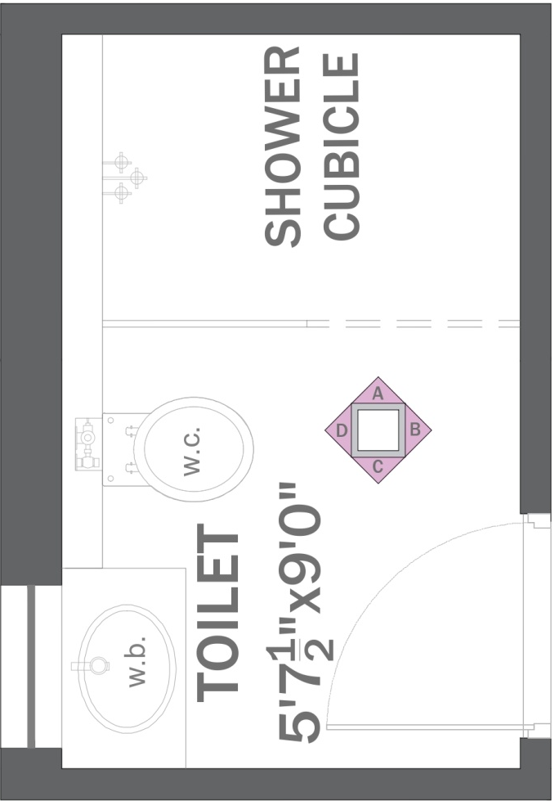
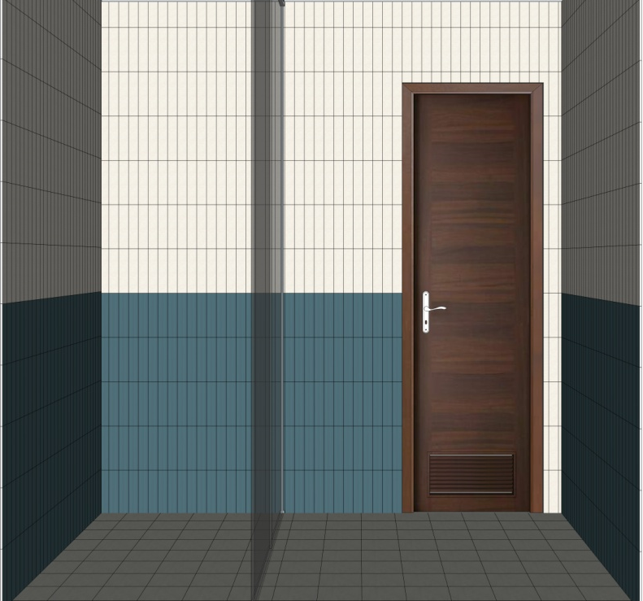
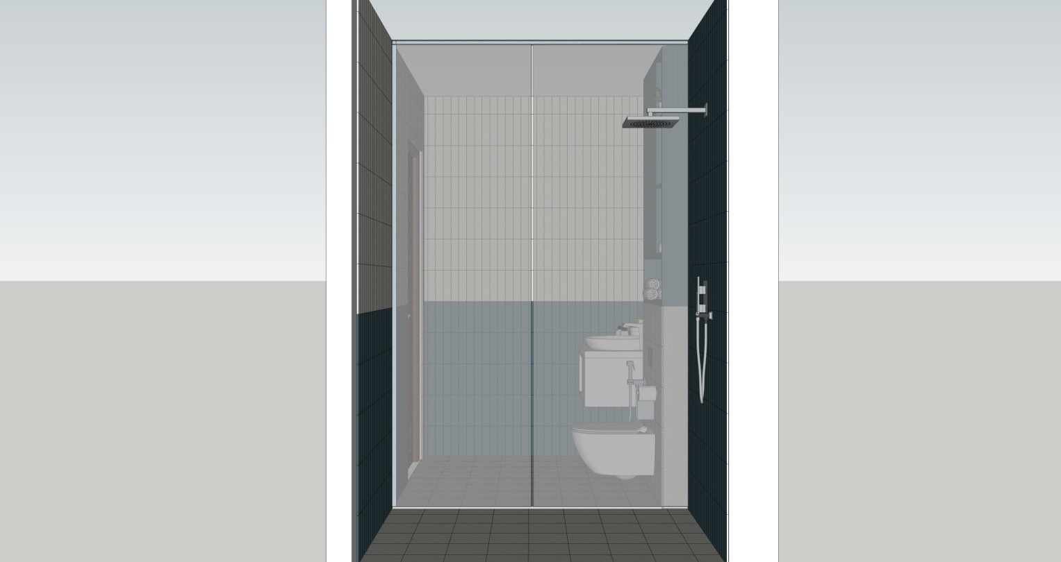
ELEVATION-A
ELEVATION-B
CHILDREN BEDROOM TOILET
PLAN
ELEVATION-C
ELEVATION-D

Slide 11
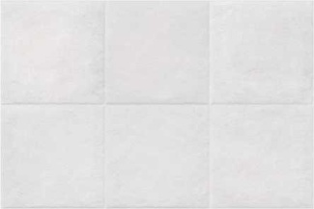
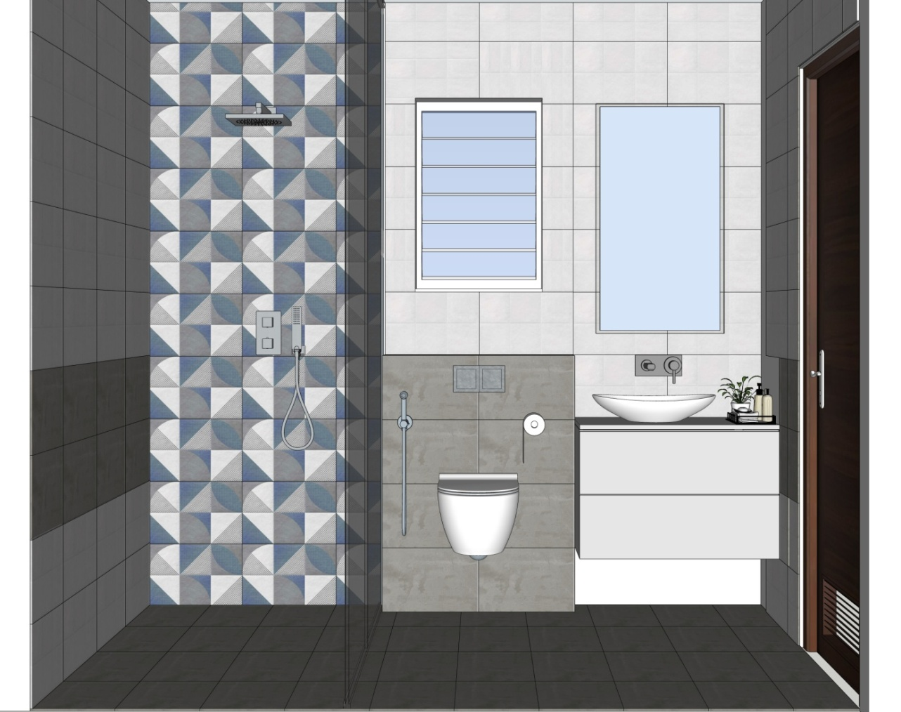
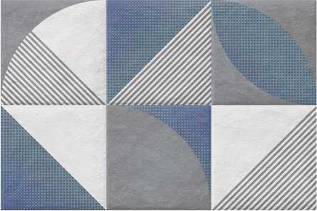
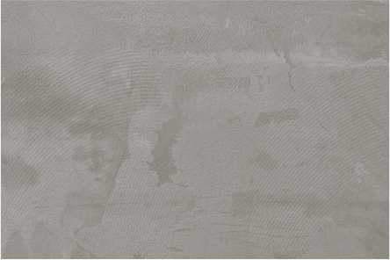
GUEST BEDROOM TOILET
SIMPOLO TILES
84004 – FLORA SKID
300X450mm | 8.2 mm | MATT|
LINK
SIMPOLO TILES
85004 – FLORA SKID
300X450mm | 8.2 mm | MATT|
LINK
SIMPOLO TILES
86000– FLORA SKID
300X450mm | 8.2 mm | MATT|
LINK

Slide 12

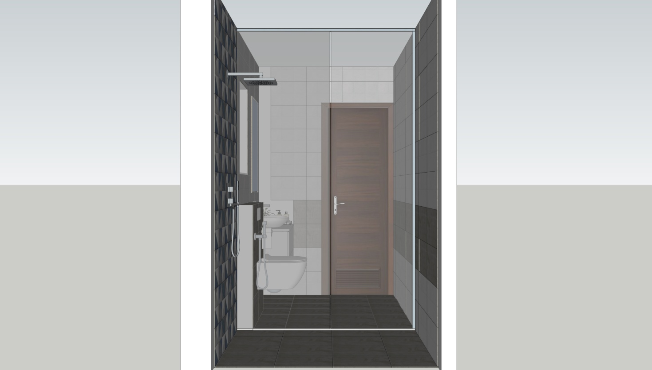
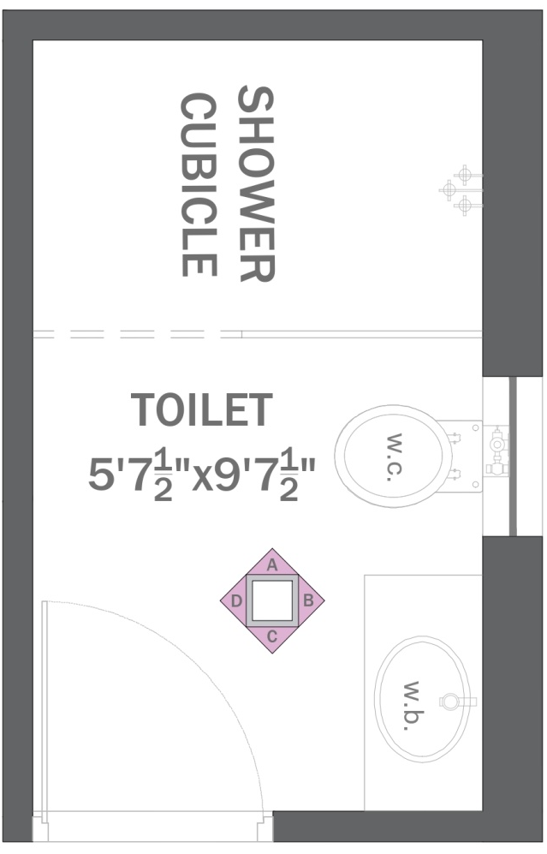
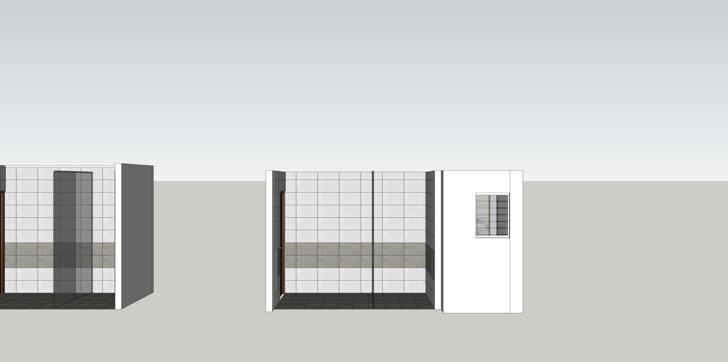
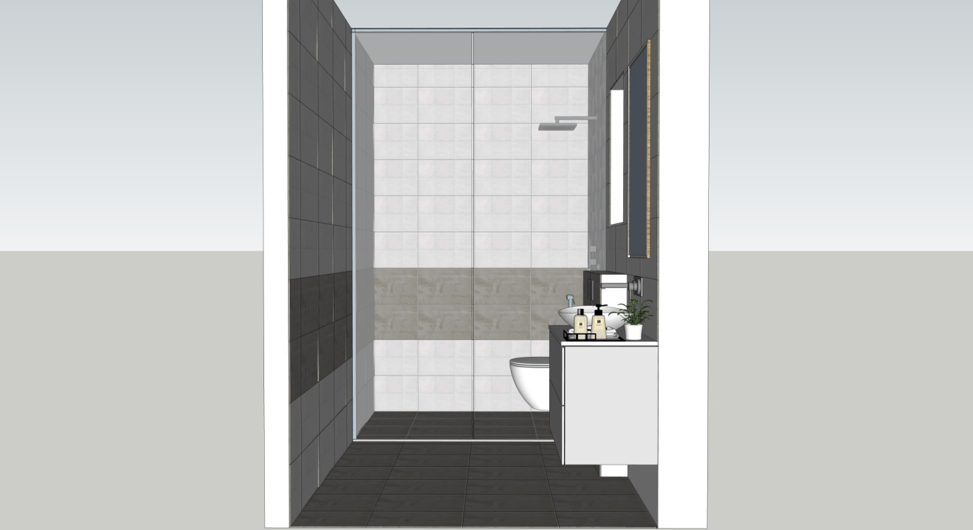
ELEVATION-A
ELEVATION-B
GUEST BEDROOM TOILET
PLAN
ELEVATION-C
ELEVATION-D

Slide 13
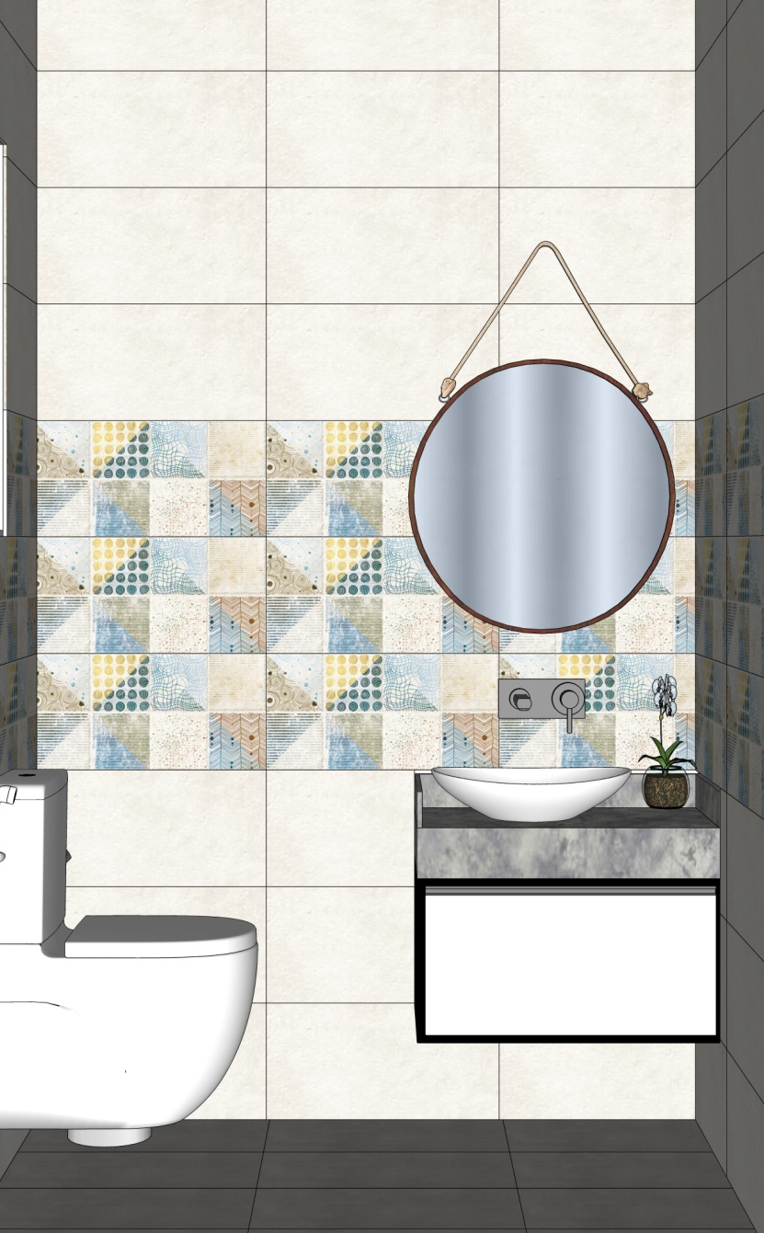

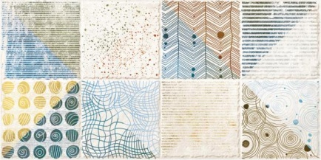

2ND FLOOR POWDER ROOM
SIMPOLO TILES
16001 – FLORA SKID
300X600mm | 8.5 mm | MATT|
LINK
SIMPOLO TILES
26001 – FLORA SKID
300X600mm | 8.5 mm | MATT|
LINK
SIMPOLO TILES
37043 – FLORA SKID
300X600mm | 8.5 mm | SATIN|
LINK

Slide 14
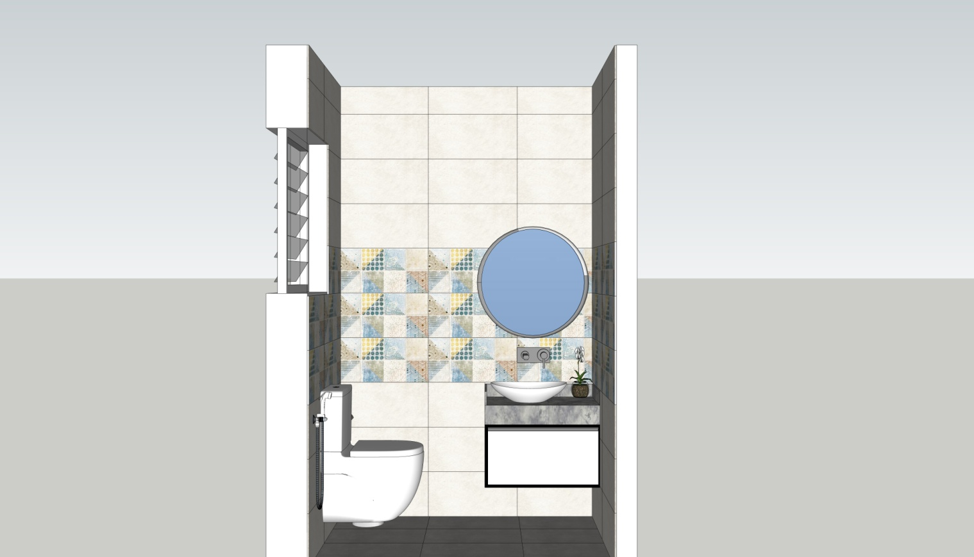
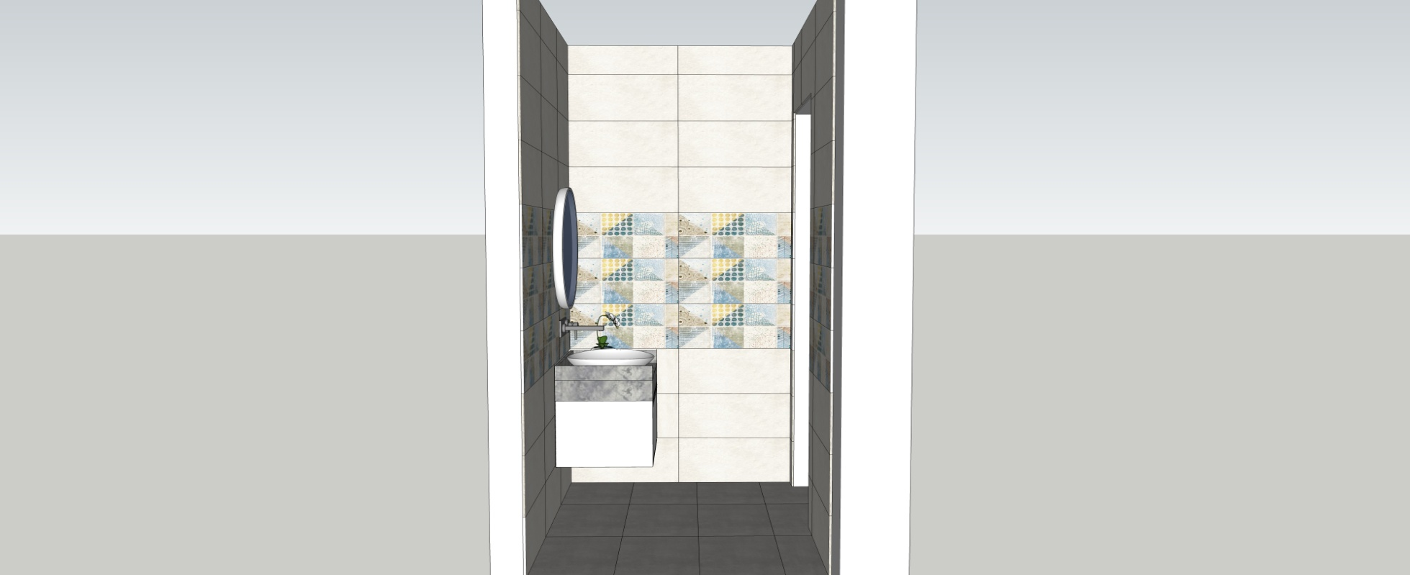
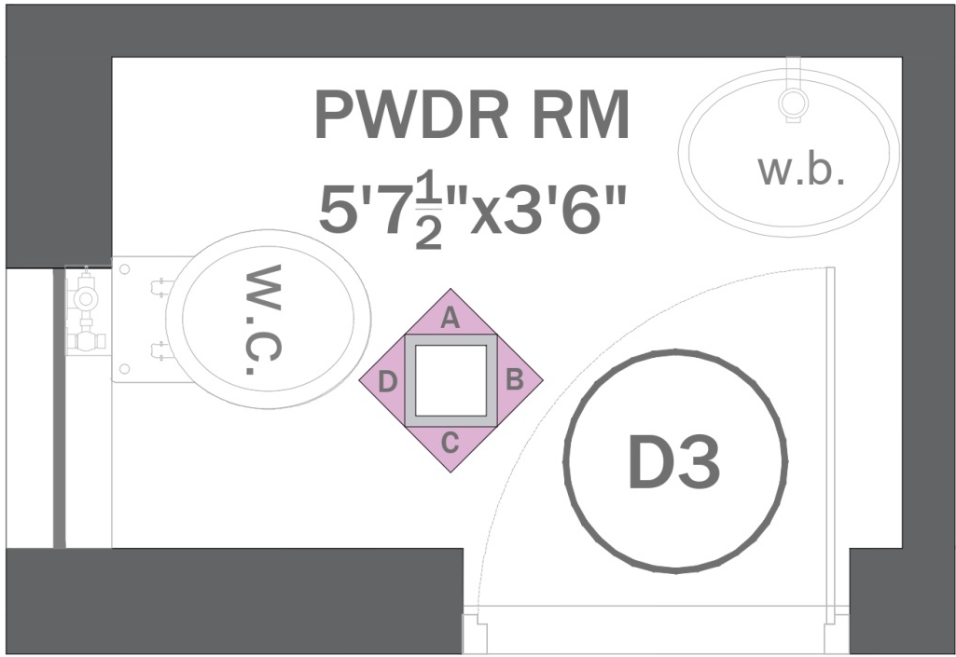
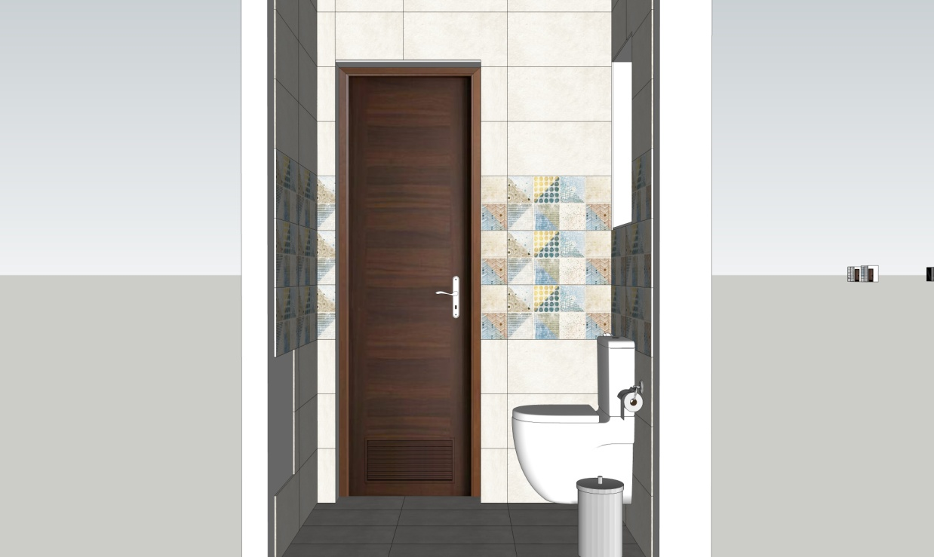
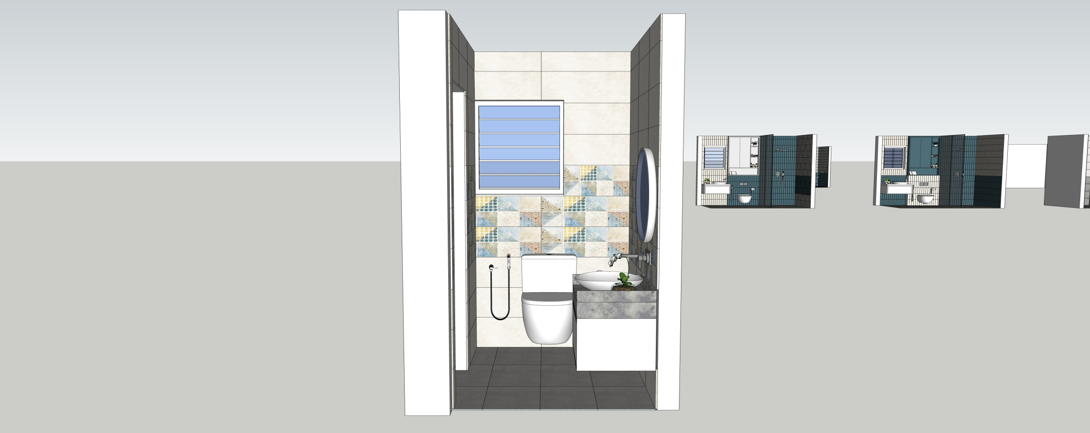
ELEVATION-A
ELEVATION-B
2ND FLOOR POWDER ROOM
PLAN
ELEVATION-C
ELEVATION-D

